Slide 1
Scofield ROA
Annual Meeting 2015

Slide 2
Agenda
Call to Order
Introductions
Guest Speaker – Leslie Pool
Proof of Notice
Approval of Prior Minutes
Report of Officers
Committee Reports
Election of 1 Director
New Business

Slide 3
Welcome to your 2015 Annual Meeting!

Slide 4
Scofield ROA Board
President: Debbie Southerland
Vice President: Barton Layne
Secretary: Pete Patterson
Treasurer: Dan Frasier
Member at Large: Paul Maine
HOA Managers – Lori Hollis and Peggy Kuhns

Slide 5
Special Guest: District 7 City Council Representative Leslie Pool

Slide 6
Proof Of Notice – Lori Hollis

Slide 7
Approval of Prior Minutes – Pete Patterson

Slide 8
Report of Officers

Slide 9
President’s Report
Scofield ROA Board of Directors’ Mission:
To protect and enhance the quality of life for our residents by focusing our efforts on the following areas:
Equitable enforcement of covenants
Fiscally responsible management of HOA assets
Proactive advocacy for our neighborhood
Fostering a sense of community between our residents
We will act on these tasks with an eye toward balancing the rights of the individual with the rights of the community.

Slide 10
President’s Report
Key projects in 2014-2015:
Largest project was landscaping updates at Foal, Cutting Horse, Scofield Farms and Chasewood entrances:
Worked with local landscaper Lisa LaPaso.
Lisa used native and adapted perennial xeriscape plants chosen for their low water and low maintenance qualities.
HOA's are making the change to perennial xerophytic plants to reduce the cost to the homeowners of expensive annual color programs and for the important effort towards water conservation in a record drought.
We have now converted all entrances and the pool area to xeriscaped areas.
List of plants used is available in your packet.
.
Erosion prevention work on west side of Metric
Irrigation Audit Preparation
Updated ACC form and checklist
Purchase of ROA ladder and power washer
New ACC member selection
Travis County Constable patrols
Connecting with new APD District Representative, Adam Soliz
SF Drive mailbox replacement
Move to quarterly dues payments
Repair of west side of Metric Fencecrete

Slide 11
Landscaping Updates
Park at Scofield Entrance - North

Slide 12
Landscaping Updates
Park at Scofield Entrance - South

Slide 13
Landscaping Updates
Foal Entrance

Slide 14
Landscaping Updates
Cutting Horse Entrance

Slide 15
Landscaping Updates
Cutting Horse Entrance

Slide 16
Landscaping Updates
Main Entrance (Scofield Farms Drive)

Slide 17
President’s Report
Key projects in 2014-2015 continued:
Landscaping/Irrigation continued (Major Hess Lawns projects)
Erosion prevention updates on west side of Metric
Gravel/rock border for areas where grass will not grow
Planting Jasmine in some areas
Trimming trees to allow sunlight to penetrate
Preparation for July 2015 irrigation audit
Moving heads in so they will not spray street
Repairing broken heads
Replacing spray with drip irrigation in narrow medians

Slide 18
President’s Report
Key projects in 2014-2015 continued:
Maintenance
Fencecrete repairs on west side of Metric – straightening of leaning columns and posts
Purchase of HOA owned maintenance supplies (ladder and power washer) to save costs
Architectural Control Committee
Selection of new ACC Member – Natalie Moore
Redesign of ACC application form

Slide 19
President’s Report
Key projects in 2014-2015:
Tax Appraisal
2014 appraised value of pool property from Travis County went up over 400% from $56,952 to $291,315.
We filed a protest and attended a formal hearing (today) and were able to get the appraised value reduced to $10,600, which is comparable to other similar size HOA pool properties nearby.
We were also directed to file a protest for 2015, because our appraised value is $328, 503. Hopefully, this should be corrected with few hassles.

Slide 20
President’s Report
Key projects in 2014-2015:
Security
Continued work with Scofield Farms Market management, Austin Police Department and business owners to deal with homeless and dumpster noise issues at the shopping center.
Criminal trespassing authorization letter signed by Inland American Management again in August 2014
Regular cleanup of tower area and bushes
Coordination of dumpster pickup under one vendor
Established relationship with new Austin Police district representative for east side of neighborhood (Adam Soliz)

Slide 21
President’s Report
Key projects in 2014-2015 continued (Ongoing projects):
Continued updates to documentation website for board and committee members
Continued updates to scofieldfarms.org website
Continued tradition of social and community events
Movie at the Pool – June 2014
Fourth of July Party – July 2014
Reptile Show – August 2014
Neighborhood Night Out – October 2014
Holiday Hayride – December 2014
Easter Egg Hunt – April 2015
Garage Sale – May 2015
Jazz at the Pool – May 2015

Slide 22
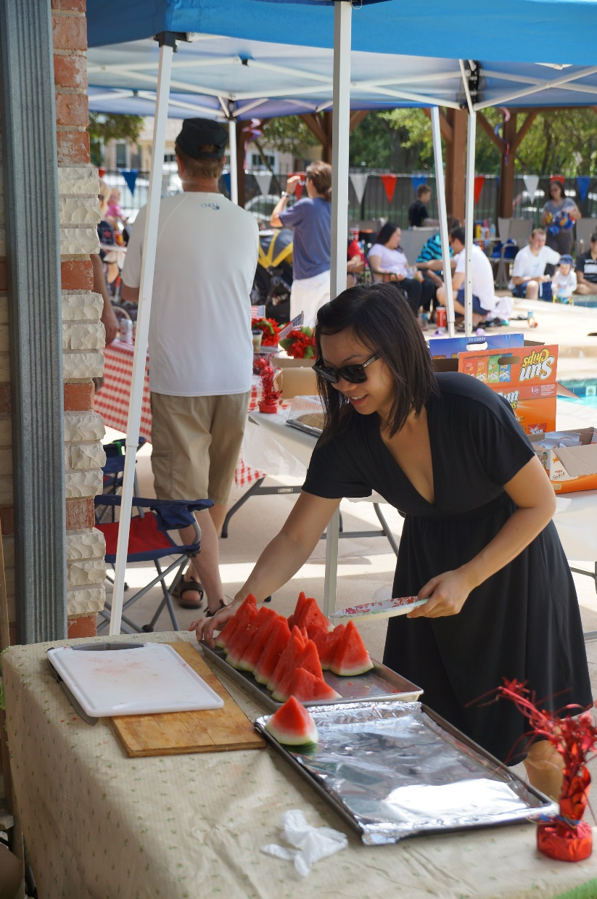
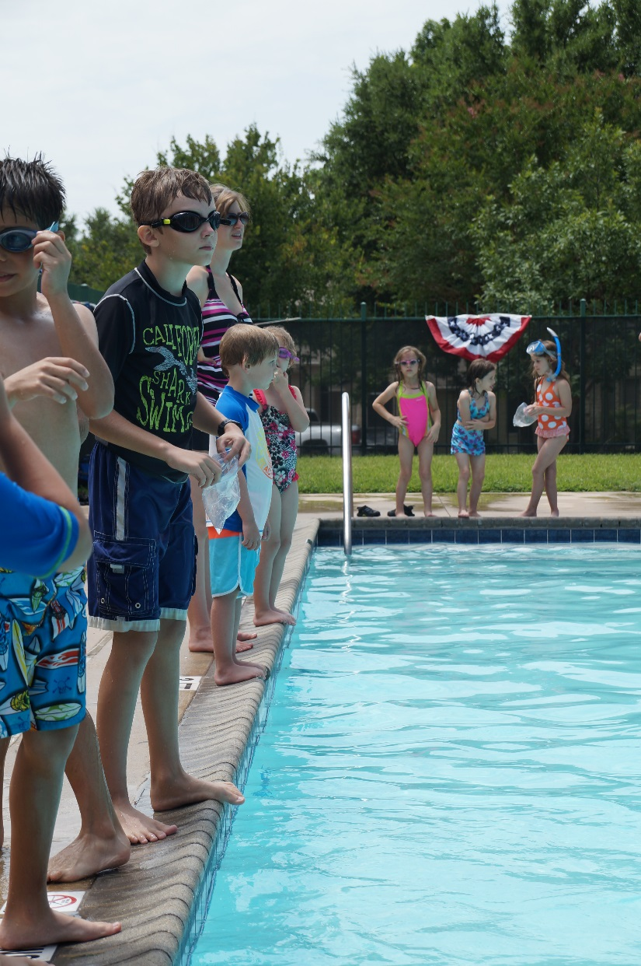
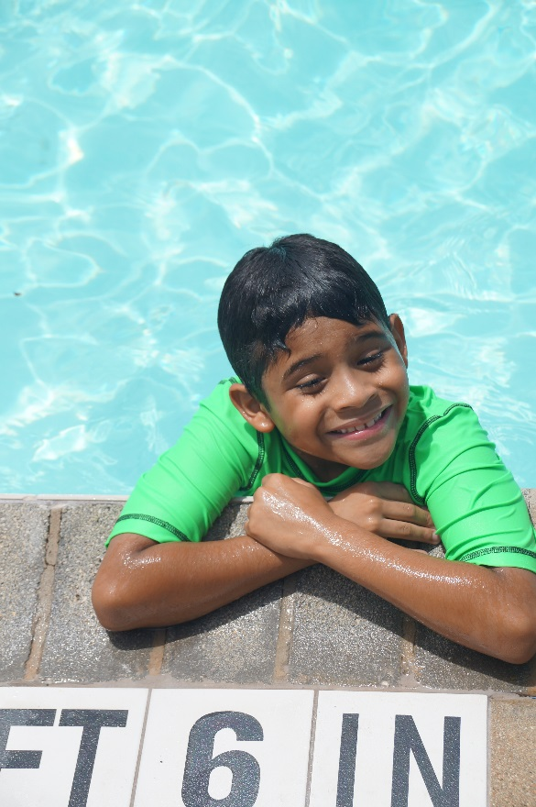
Social and Community Events

Slide 23
2015-16 Initiatives
Irrigation Audit
Rules and Regulations Document created and filed
Continued update of ACC forms
Continued social and community events

Slide 24
Technical Resources
Refer to handout in packet
ROA sponsored:
Scofieldfarms.org website
Scofieldfarms.org website forum
Scofield Farms email newsletter
Scofield Farms Instant Communicator
Other:
Scofield Yahoo group
Nextdoor Scofield Farms

Slide 25
Treasurer’s Report – Lori Hollis
Balance Sheet Through 4/30/2015
Operating $71,132.97
Money Market $16,523.47
Reserves $147,565.87
Total Assets $235,222.31

Slide 26
Treasurer’s Report – Lori Hollis
Accounts Receivable As of April 30, 2015
Accounts Receivable $98,877.36
Commercial Accounts $9,968.28
Fines $67,152.08
Assessments & Other Fees $21,757

Slide 27
Deed Restriction Violations – Lori Hollis
Trash can Storage
Fence Maintenance
Home Maintenance
Landscaping
Dead grass or bare areas
Weeds
Mowing & edging
Grass in beds

Slide 28
Architectural Control Committee Report

Slide 29
Committee Reports
Pool – Maria Shelby
Park – David Books
Welcoming Committee – Carol Robbins

Slide 30
Committee Needs
Neighborhood Watch
Welcoming Committee
Social Committee

Slide 31
Many thanks to our Event Organizers!
Fourth of July Party – Carol Robbins, Marty Robbins, Sue Hoke
Holiday Hayride – Dallas Yenawine
Easter Egg Hunt – Debra Wissman, Fellowship at Scofield Farms
Spring Garage Sale – Wynn Hutter
Jazz at the Pool – Diane Harvey, Erika Herrera

Slide 32
Election of 1 Director

Slide 33
New Business/Questions

Slide 34
Thank you, Scofield Farms, for a great year!
Adjournment

